Slide 1






Notes:
Topic?
Who?
4 portions!!!

Slide 2
Table of Contents
Descriptions of the Project goals
Exploratory Analysis
Solutions and insights

Slide 3



Slide 4
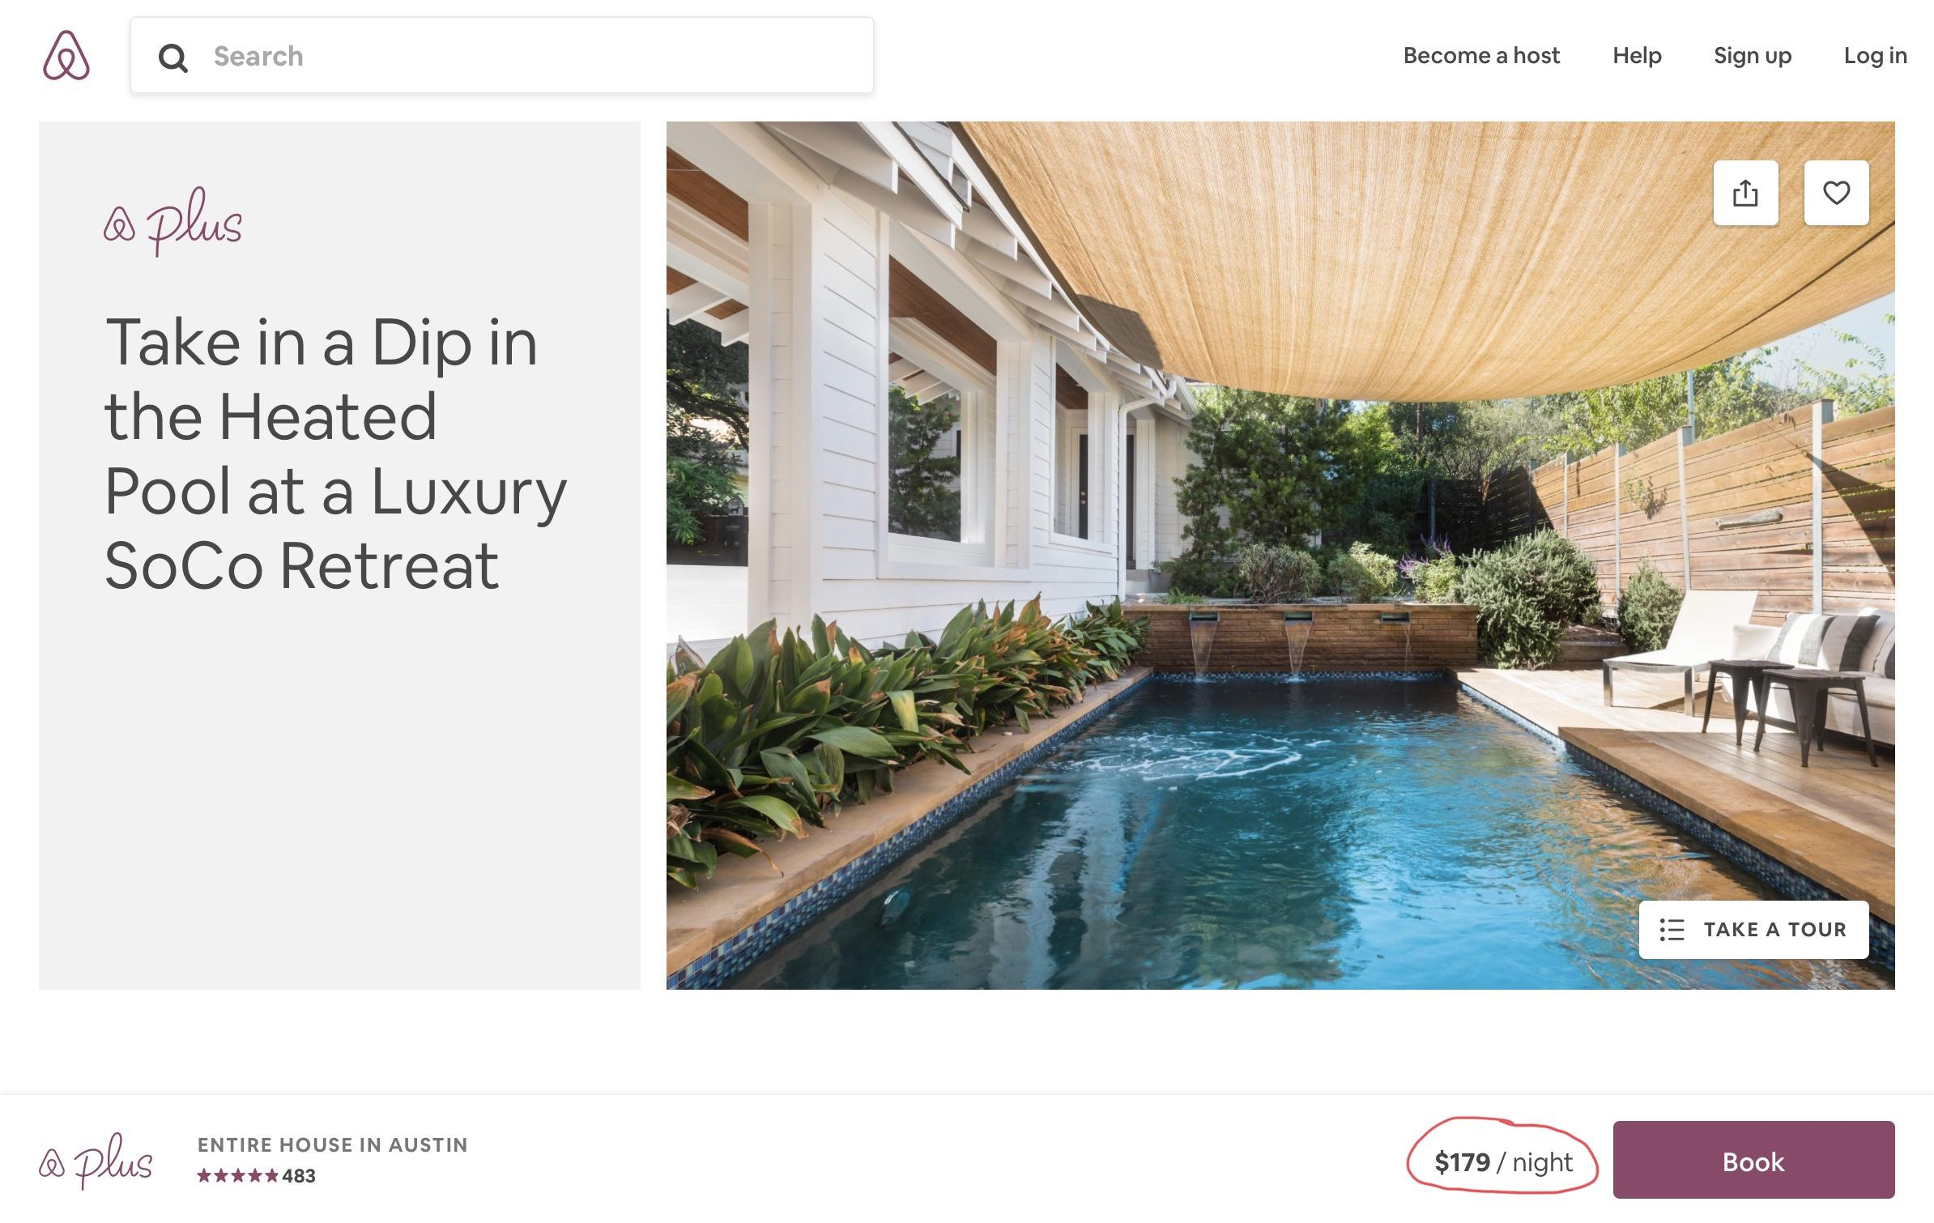
Pricing Problem
Source: Airbnb.com
Notes:
As customer: price
As a host: what price should I set to price

Slide 5
Description
Dataset:
the Airbnb Dataset in Austin area.
Questions:
Key features for influencing pricing of the listings
Provide listings’ recommendations for existing hosts
Provide approximate pricing ranges for incoming hosts

Slide 6
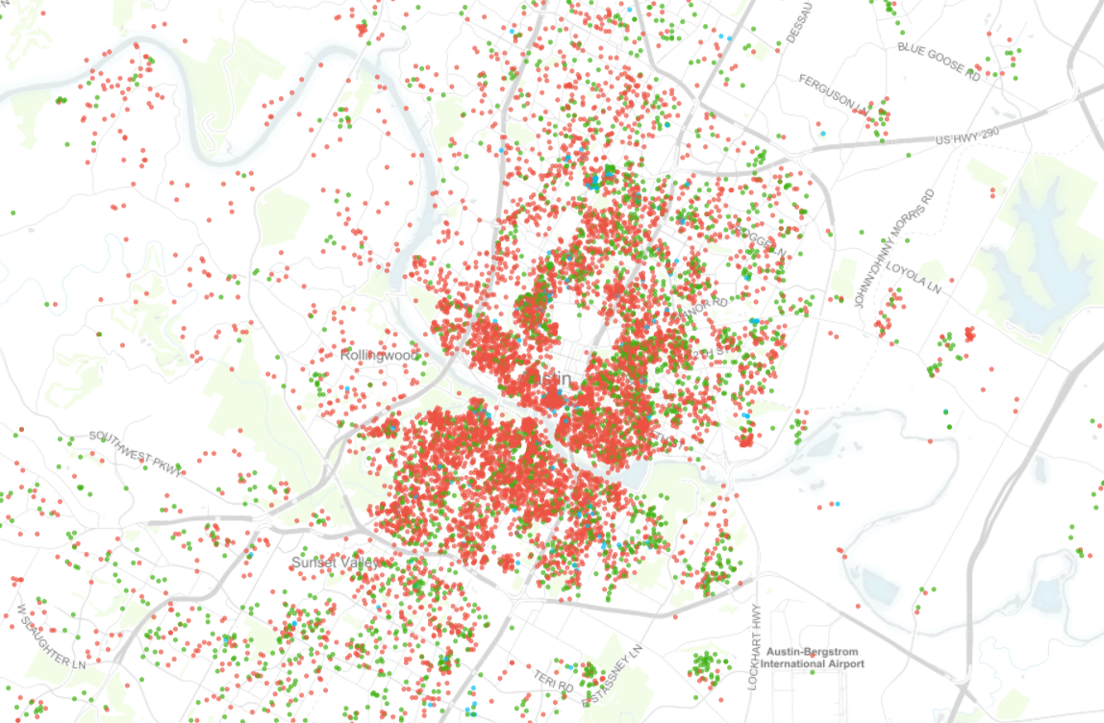
Importance
Number of listings: 11091
Number of listings: 9963
Economic Impact
Host: more profit
Customer: more pleasant experience
Airbnb: increase the quality of listings
Austin: boost the touring industry
Source:http://insideairbnb.com/austin/
Notes:
2:00
For Host, Helping set optimal price, more profit
For customer,make money worth it, have a pleasant experience,
Boost the Airbnb platform and a good incentive for local touring industry

Slide 7


Slide 8
First Look: Features
Superhost Status
Host Verifications
Host’s Profile Picture
Host’s Identity
Accurate Location
Room Type
Instant Bookable
Bathrooms
Bedrooms
Amenities
Security Deposit
Number of Reviews
Review Scores
Cancellation Policy
9663 Observations
Notes:
2:30
Make sure to explain how we get those features from 95 features.
By common sense, using numerical value or convert useable text into numerical or dummy variable.

Slide 9
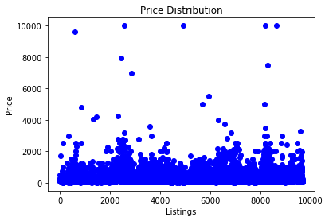
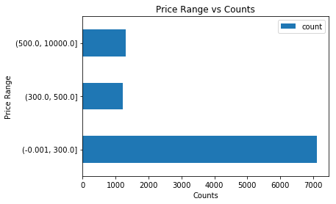
Listings’ Price Range
Nearly 70% of the listings have prices lower than $300 Dollar Per night
Notes:
First, we plot all the listings’ price and found that most listings’ prices are under $1,500. Then we ranked all the listing prices from low to high, and divided them into three different groups: first 70% of all the prices, 70% - 85%, and above 85%. The numerical price range corresponding to each group are $0 - $300, $300 - $500, and $500- $10,000. We conclude that about 70% of the listings have listing prices lower than $300 per night.

Slide 10
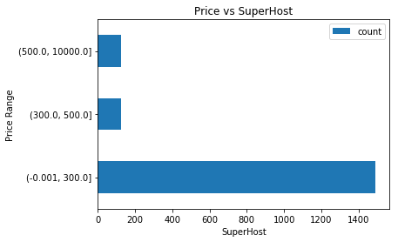
Price vs Superhost
Price Range | % | count
0~300 | 85% | 1492
300~500 | 7% | 122
500~ | 8% | 126
Total: 1740 listings are posted by Superhosts
Notes:
According to the Airbnb website, Superhosts are experienced hosts who provide shining examples for other hosts, and extraordinary experiences for their guests. We are curious about whether listings posted by Superhosts have higher prices. We selected a total of 1740 listings that are posted by Superhosts and fit them into the price range mentioned in the previous slide. From the table, we can see that most of these listings fall into the range of $0 - $300. We conclude that even for Superhosts, most of them do not charge higher prices. Maybe what makes them distinguished from normal hosts are the better services or room settings.

Slide 11
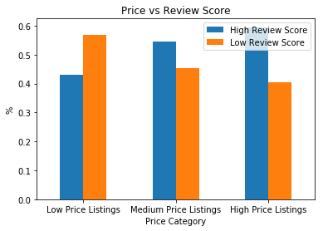
Price vs Review Score
Price Listing | Review Score | count
Low | Low | 56.8%
 | High | 43.2%
Medium | Low | 45.3%
 | High | 54.7%
High | Low | 40.5%
 | High | 59.5%
Higher listing price => higher percentage of high review score
Notes:
For price range mentioned in the precious slides, we labeled them as low, medium, and high price listings. Additionally, since listings with review scores higher than 99 are deemed to be superior, we chose 99 as a cutoff to distinguish between high review score and low review score. Then we compare the percentage of high review score listings and low score listings within each price range. From the result, we found that as listing price gets higher, the percentage for high review scores within that price range also gets higher. A potential reason might be that for places with higher listing price, they have better amenities or provide better services. Another reason might be that high price listing tend to have larger sizes so they are capable of accommodating more guests at a time. Taking all these into account, it easier for the guests to gain memorable experiences, so they are more likely to leave better ratings.

Slide 12
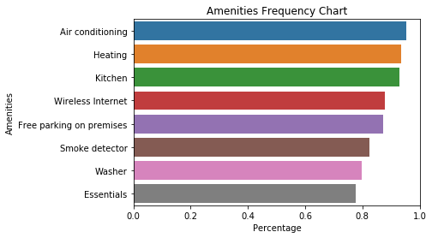
Amenities
Rank | Amenities | Ratio
1 | Air conditioning | 0.95
2 | Heating | 0.93
3 | Kitchen | 0.93
4 | Internet | 0.88
5 | Parking | 0.87
6 | Smoke Detector | 0.82
7 | Washer | 0.80
8 | Essentials | 0.77
Notes:
5:30
Finally, we would like to see what amenities are the most common among all the listings. We counted the occurrence of different amenities. The result shows that the top 8 most common amenities are air conditioning, heating, kitchen, internet, parking, smoke detector, washer, essentials. These amenities might be evaluated as important ones by the guests.

Slide 13
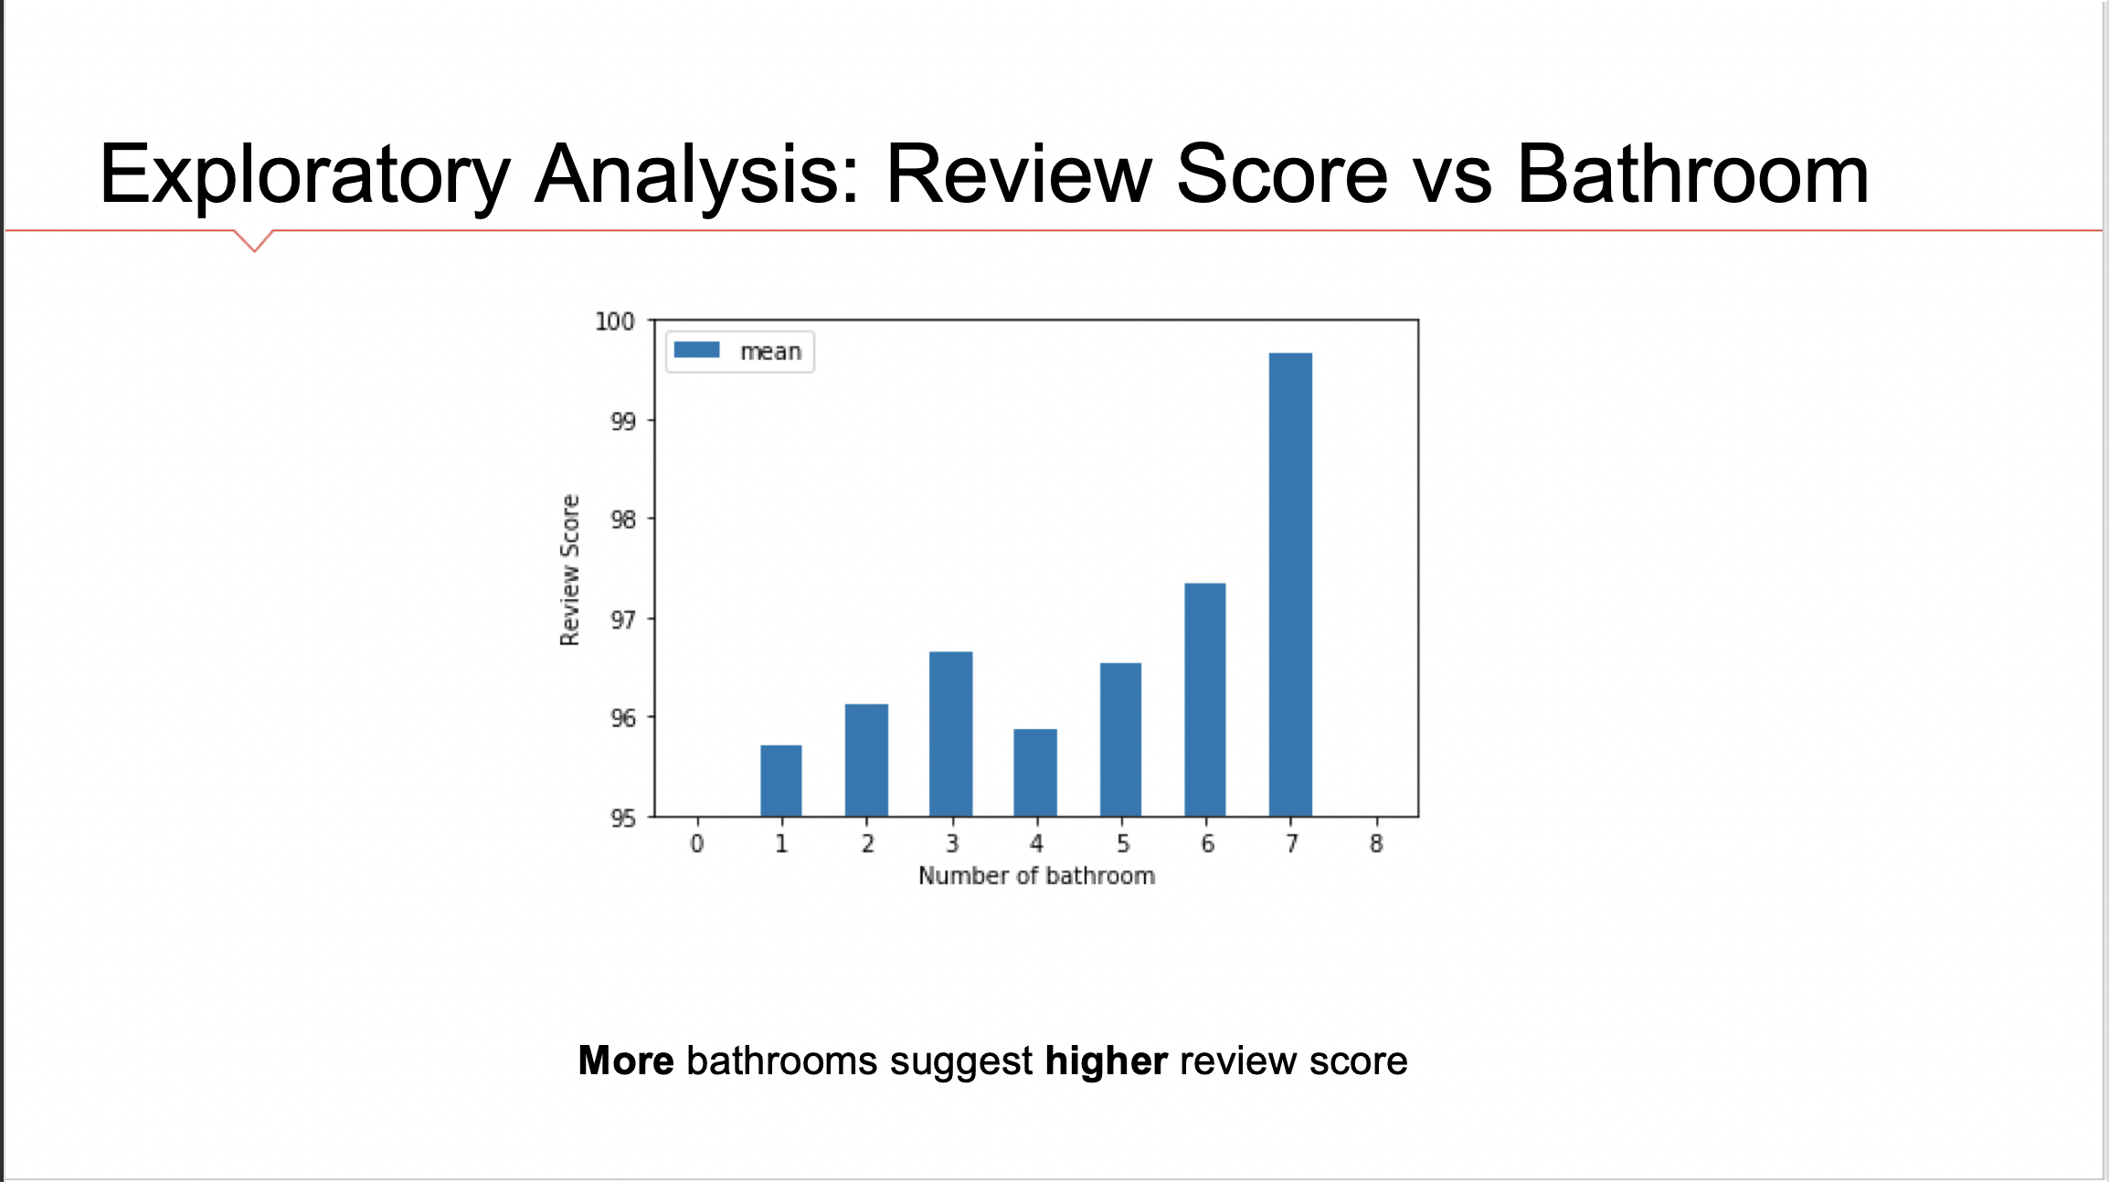

Slide 14


Slide 15
Classifiers
Logistic Regression Model
Tree Models
Decision Tree
Bagging
Random Forests
Gradient Boosting

Slide 16
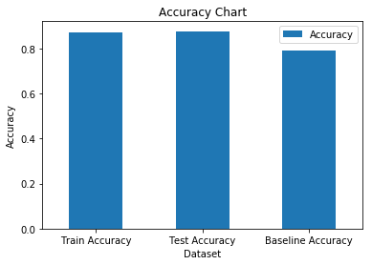
Summary - Logistic Regression
Positive Class: >$300
Negative Class: <=$300
0.872
0.878
0.794
Train Accuracy: 0.872
Test Accuracy:0.878
Baseline Accuracy = 0.794
Notes:
300 $ Watershed - 70% -30%
Why 300$?

Slide 17
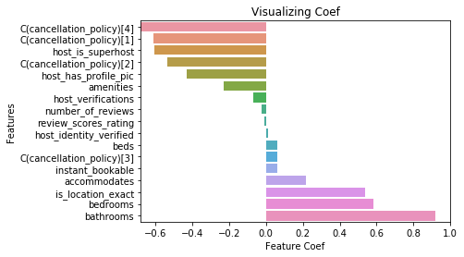
Analysis - Logistic Regression
Most Important Features:
Cancellation Policy:Negative
Superhost:Negative
Bath/Bed:Positive
Notes:
7:30~8:00
But can only split the price into 2 dummies 300

Slide 18
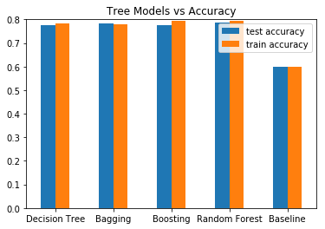
Summary - Tree Models
Split Listings‘ Price into three bins:
<= $200
$200 ~ $400
> $400
Random Forest outperforms all three other models with an accuracy of nearly 80%
Notes:
Low price 200 affordable
Medium price 200~ 400 compete with hotels
High price 400 luxury castle in lake travis

Slide 19
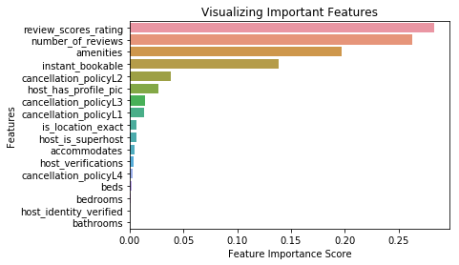
Analysis - Random Forest
The exploratory analysis
More number of reviews, the better?
More amenities, the better?
Instant bookable?
Notes:
From above, we could see that the most important features are review_scores_rating;number_of_reviews;amenities;instant_bookable;cancellation_policyL2
Review score price , 高 -》高？
Number of reviews 多—》高？
Amenities 多，好——》高？
Feature importance is calculated as the decrease in node impurity weighted by the probability of reaching that node. The node probability can be calculated by the number of samples that reach the node, divided by the total number of samples. The higher the value the more important the feature

Slide 20
Recommandation
Improve Review score
Increase the number and the quality of amenities
Try to make the listing ‘Instant bookable’
Try to make the customer to write reviews after staying
Try not to make the cancellation policy too strict
Become the Superhost: Try to make same listings at a lower price point

Slide 21


Q&A
Notes:
10:00

Slide 22

Thank You

